Slide 1

Deep dive into Dynamic Provisioning with AWS EBS CSI Driver
Presenter:
Ali Parsfar (he/him)
Date: Jun 2023

Slide 2
Kubernetes Volumes
What we will learn in this session:
1- We learn about components of CSI Driver and aws-ebs-csi-driver.
2- Component involvement in binding an EBS volume to a pod.
3- Workflow of dynamic provisioning with PVC and ebs-csi-driver.
4- What is going under the hood in Nodes in this process.

Slide 3
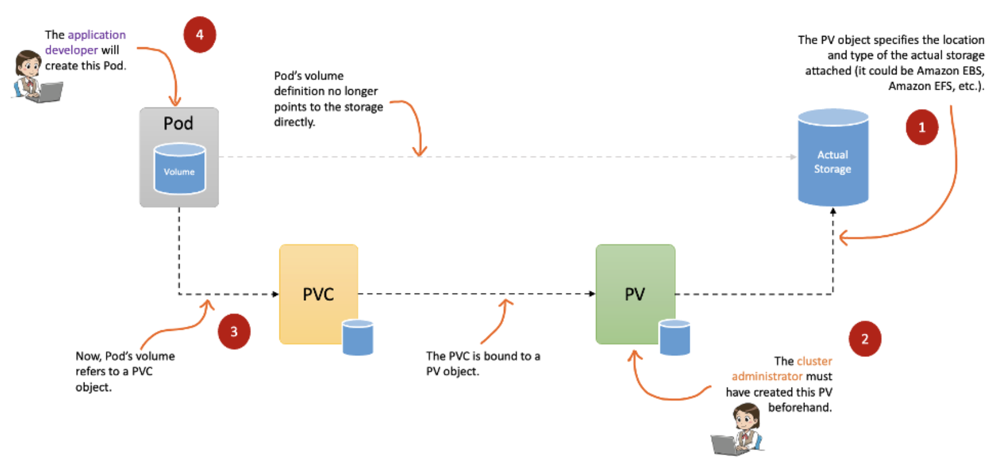
Static Provisioning

Slide 4
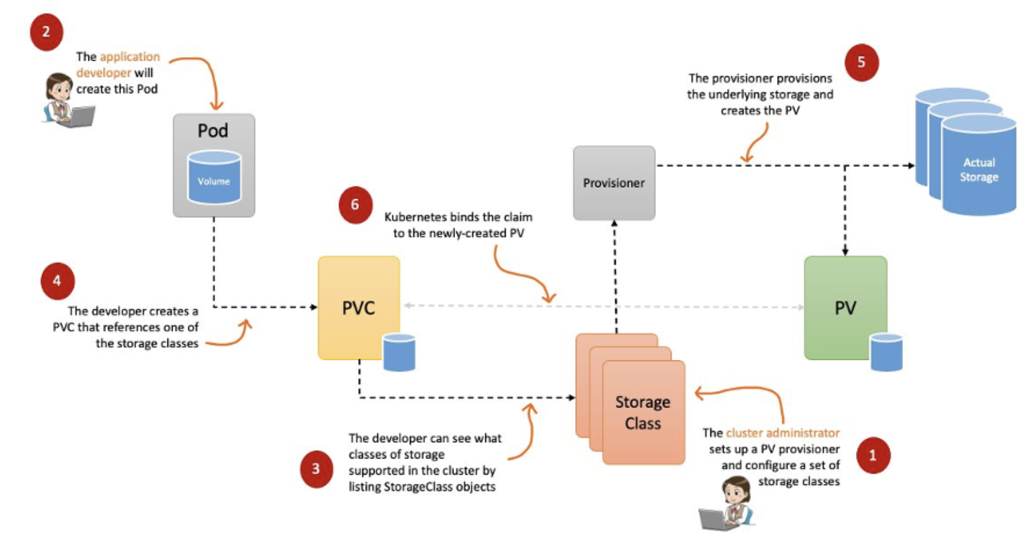
Dynamic Provisioning

Slide 5
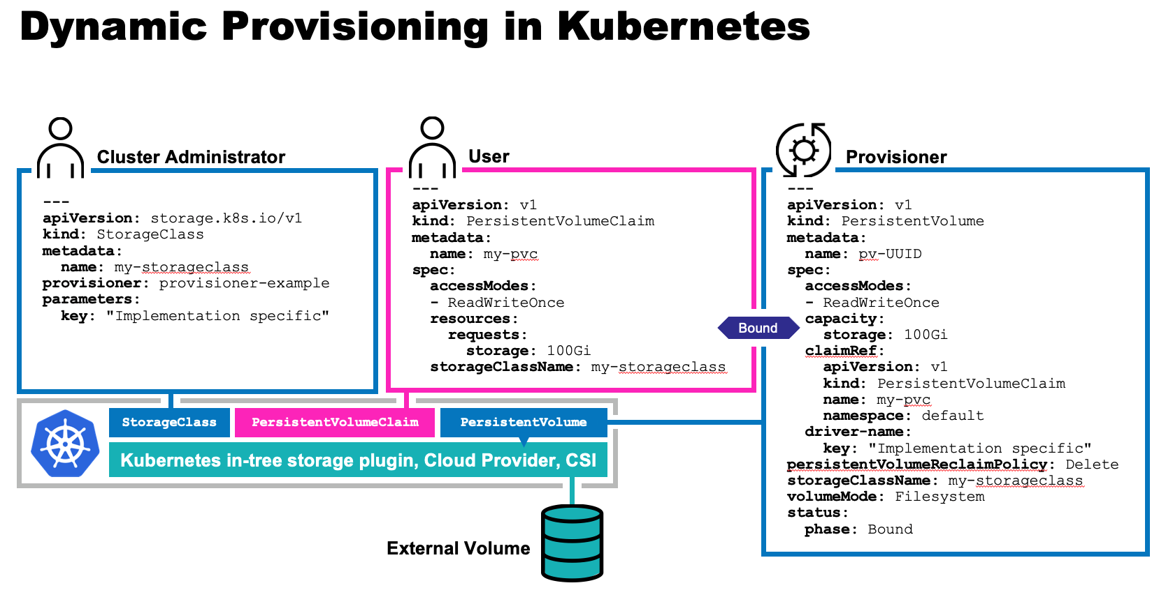
Dynamic Provisioning

Slide 6
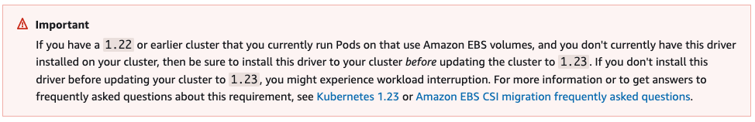
History
The Amazon Elastic Block Store Container Storage Interface (CSI) Driver provides a CSI interface used by Container Orchestrators to manage the lifecycle of Amazon EBS volumes.
CSI was developed as a standard for exposing arbitrary block and file storage storage systems to containerized workloads on Container Orchestration Systems (COs) like Kubernetes. With the adoption of the Container Storage Interface, the Kubernetes volume layer becomes truly extensible. Using CSI, third-party storage providers can write and deploy plugins exposing new storage systems in Kubernetes without ever having to touch the core Kubernetes code. This gives Kubernetes users more options for storage and makes the system more secure and reliable.
As we all know in the Kubernetes version 1.23 and higher , there is no `In-Tree` driver for EBS in the Kubernetes . And customers must install ebs-csi-driver add-on for interaction with EBS volumes .

Slide 7
How to write a CSI Driver?
The kubernetes-csi site details how to develop, deploy, and test a CSI driver on Kubernetes. In general, CSI Drivers should be deployed on Kubernetes along with the following sidecar (helper) containers:
external-attacher = Watches Kubernetes `VolumeAttachment` objects and triggers `ControllerPublish` and `ControllerUnpublish` operations against a CSI endpoint.
external-provisioner = Watches Kubernetes `PersistentVolumeClaim` objects and triggers `CreateVolume` and `DeleteVolume` operations against a CSI endpoint.
node-driver-registrar = Registers the CSI driver with kubelet using the Kubelet device plugin mechanism.
external-snapshotter = Watches Kubernetes `VolumeSnapshot` CRD objects and triggers `CreateSnapshot` and `DeleteSnapshot` operations against a CSI endpoint.
external-resizer = watches the Kubernetes API server for PersistentVolumeClaim object edits and triggers ControllerExpandVolume operations against a CSI endpoint if user requested more storage on PersistentVolumeClaim object.
Livenessprobe = May be included in a CSI plugin pod to enable the Kubernetes Liveness Probe mechanism.
Storage vendors can build Kubernetes deployments for their plugins using these components, while leaving their CSI driver completely unaware of Kubernetes.

Slide 8
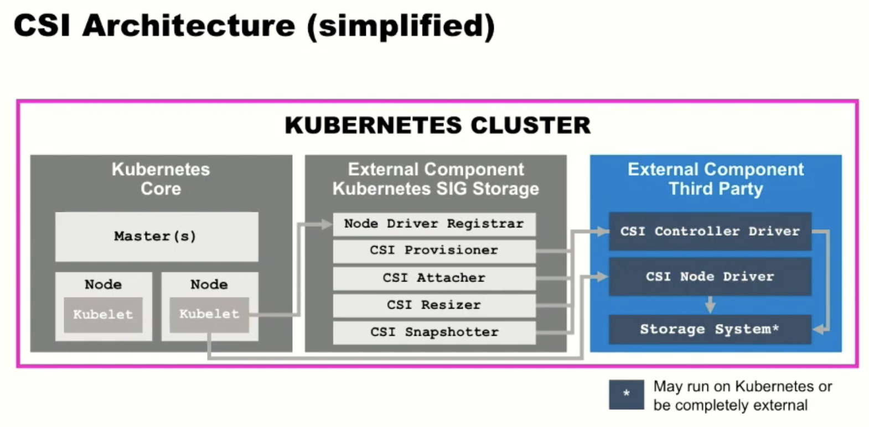
How to write a CSI Driver?

Slide 9
Brand new Cluster
Cluster Creation time
0-Cluster

Slide 10
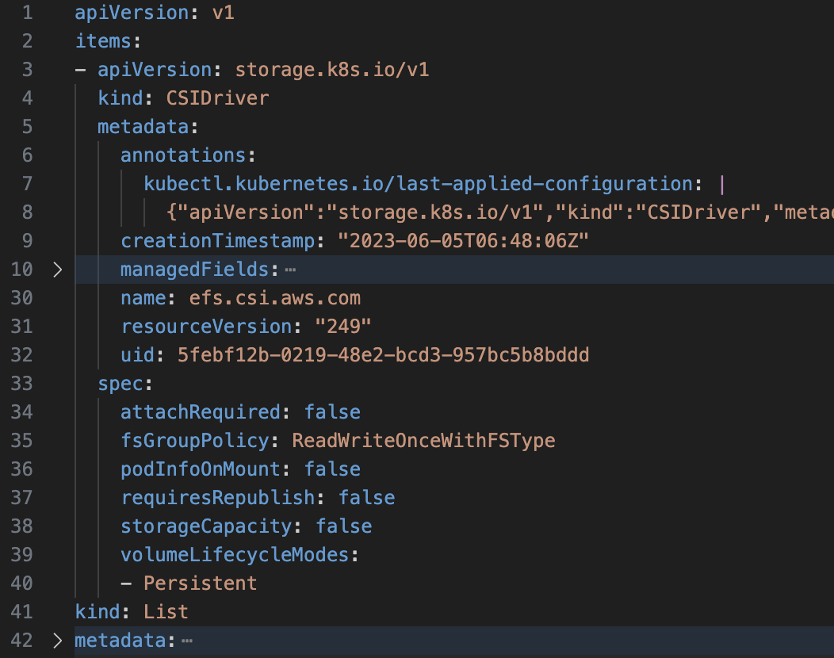
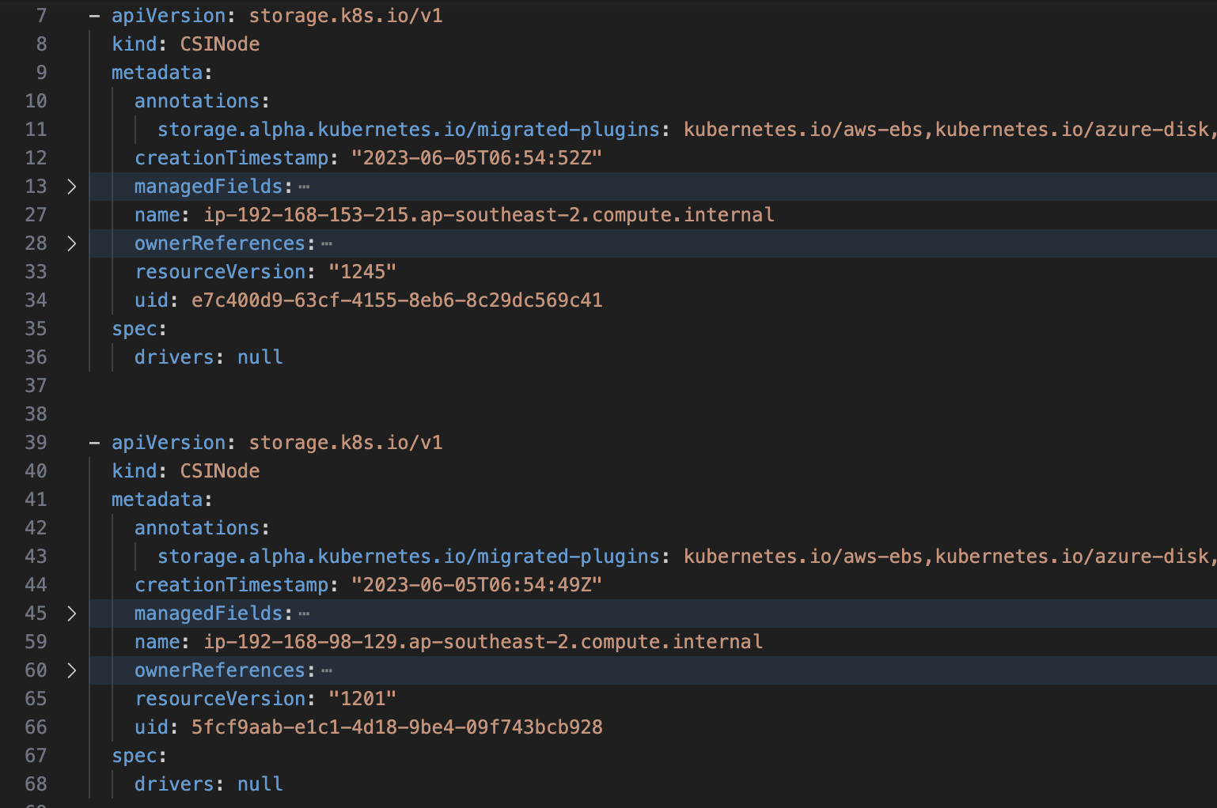
At Cluster Creation Time
CSIDriver Object CSINode Object

Slide 11
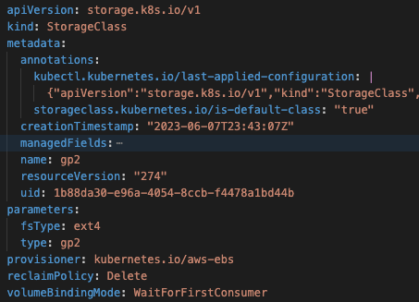
Default Storage Class

Slide 12
CSINode
What is the CSINode object?
CSINode holds information about all CSI drivers installed on a node. CSI drivers do not need to create the CSINode object directly. As long as they use the node-driver-registrar sidecar container, the kubelet will automatically populate the CSINode object for the CSI driver as part of kubelet plugin registration.
CSI drivers generate node specific information. Instead of storing this in the Kubernetes Node API Object, a new CSI specific Kubernetes CSINode object was created.
It serves the following purposes:
1- Mapping Kubernetes node name to CSI Node name, The CSI GetNodeInfo call returns the name by which the storage system refers to a node. Kubernetes must use this name in future ControllerPublishVolume calls. Therefore, when a new CSI driver is registered, Kubernetes stores the storage system node ID in the CSINode object for future reference.
2- Driver availability , A way for kubelet to communicate to the kube-controller-manager and Kubernetes scheduler whether the driver is available (registered) on the node or not.
3- Volume topology, The CSI GetNodeInfo call returns a set of keys/values labels identifying the topology of that node. Kubernetes uses this information to do topology-aware provisioning . It stores the key/values as labels on the Kubernetes node object. In order to recall which Node label keys belong to a specific CSI driver, the kubelet stores the keys in the CSINode object for future reference.

Slide 13
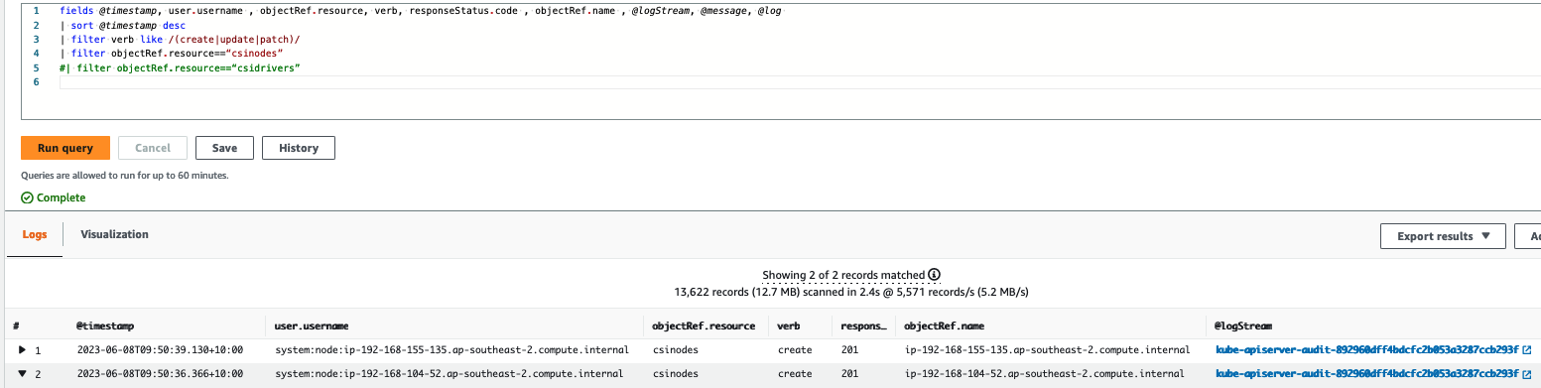
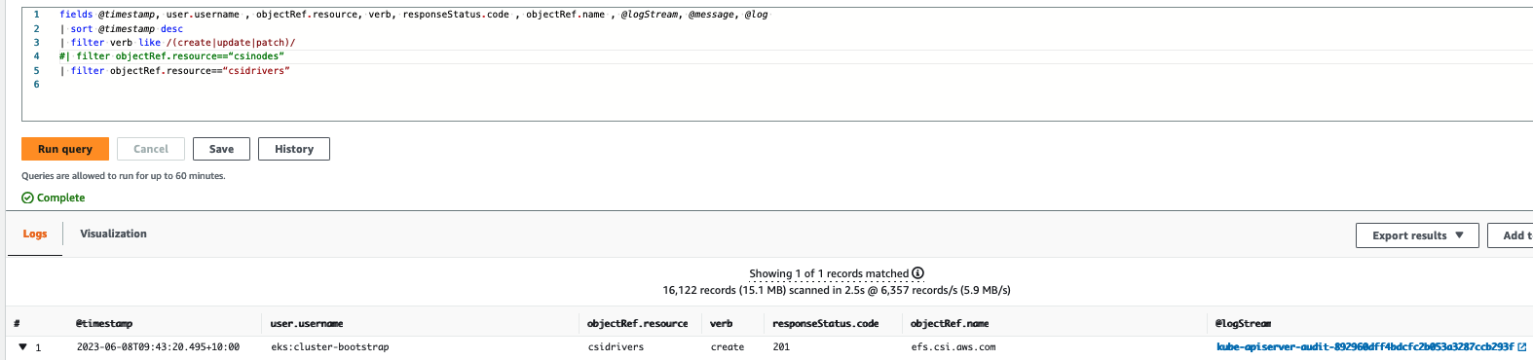
At Cluster Creation Time

Slide 14
At Cluster Creation Time
ebs % kubectl –n kube-system get sa persistent-volume-binder
NAME SECRETS AGE
persistent-volume-binder 0 6h54m
ebs % kubectl –n kube-system describe clusterrolebinding system:controller:persistent-volume-binder
Name: system:controller:persistent-volume-binder
Labels: kubernetes.io/bootstrapping=rbac-defaults
Annotations: rbac.authorization.kubernetes.io/autoupdate: true
Role:
Kind: ClusterRole
Name: system:controller:persistent-volume-binder
Subjects:
Kind Name Namespace
---- ---- ---------
ServiceAccount persistent-volume-binder kube-system
ebs % kubectl –n kube-system describe clusterrole system:controller:persistent-volume-binder
Name: system:controller:persistent-volume-binder
Labels: kubernetes.io/bootstrapping=rbac-defaults
Annotations: rbac.authorization.kubernetes.io/autoupdate: true
PolicyRule:
Resources Non-Resource URLs Resource Names Verbs
--------- ----------------- -------------- -----
persistentvolumes [] [] [create delete get list update watch]
pods [] [] [create delete get list watch]
endpoints [] [] [create delete get update]
services [] [] [create delete get]
events.events.k8s.io [] [] [create patch update]
persistentvolumeclaims [] [] [get list update watch]
storageclasses.storage.k8s.io [] [] [get list watch]
nodes [] [] [get list]
secrets [] [] [get]
persistentvolumeclaims/status [] [] [update]
persistentvolumes/status [] [] [update]
events [] [] [watch create patch update]
ebs %

Slide 15
Cluster without ebs-csi-driver
Before ebs-csi-driver
1-NoCSI
controllers["persistentvolume-binder"] = startPersistentVolumeBinderController
controllers["attachdetach"] = startAttachDetachController
controllers["persistentvolume-expander"] = startVolumeExpandController
controllers["pvc-protection"] = startPVCProtectionController
controllers["pv-protection"] = startPVProtectionController
Notes:
controllers["persistentvolume-binder"] = startPersistentVolumeBinderController
controllers["attachdetach"] = startAttachDetachController
controllers["persistentvolume-expander"] = startVolumeExpandController
controllers["clusterrole-aggregation"] = startClusterRoleAggregrationController
controllers["pvc-protection"] = startPVCProtectionController
controllers["pv-protection"] = startPVProtectionController
controllers["ttl-after-finished"] = startTTLAfterFinishedController
controllers["root-ca-cert-publisher"] = startRootCACertPublisher

Slide 16
Status – No driver installed – Test Pod with volume
No Provisioner !
SC (default)
PVC
POD Pending
kubernetes
AWS EBS
Node OS

Slide 17
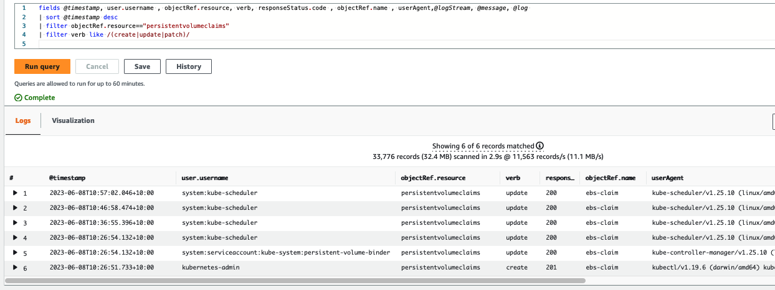
PVC Create Update Patch

Slide 18
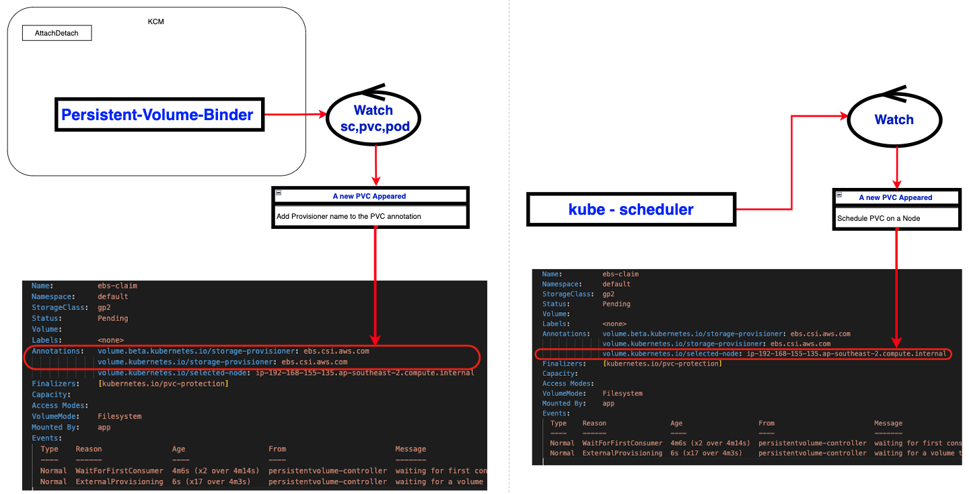
1- PVC Created

Slide 19
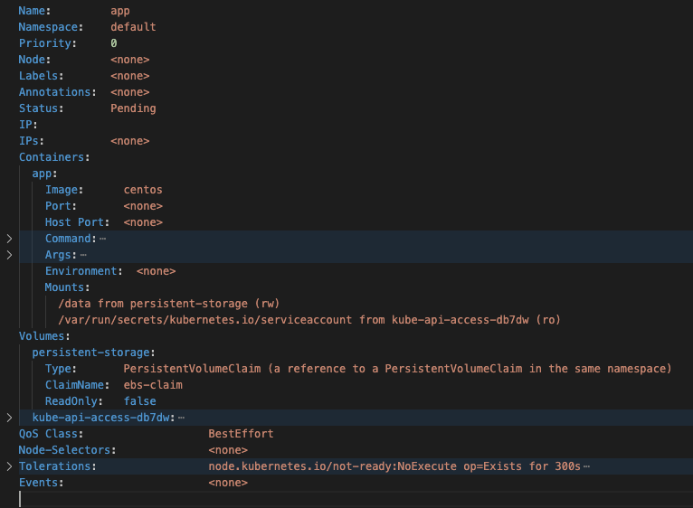
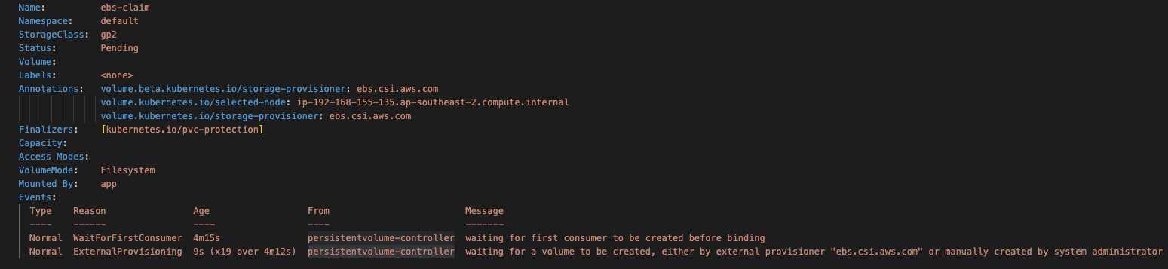
1- PVC Created

Slide 20
With ebs-csi-driver
Ebs-csi-driver installed
2-CSI

Slide 21
Kubernetes CSI Sidecar Containers
Kubernetes CSI Sidecar Containers
Kubernetes CSI Sidecar Containers are a set of standard containers that aim to simplify the development and deployment of CSI Drivers on Kubernetes.
These containers contain common logic to watch the Kubernetes API, trigger appropriate operations against the “CSI volume driver” container, and update the Kubernetes API as appropriate.
The containers are intended to be bundled with third-party CSI driver containers and deployed together as pods.
The containers are developed and maintained by the Kubernetes Storage community.
The Kubernetes development team maintains the following Kubernetes CSI Sidecar Containers:
external-provisioner
external-attacher
external-snapshotter
external-resizer
node-driver-registrar
livenessprobe

Slide 22
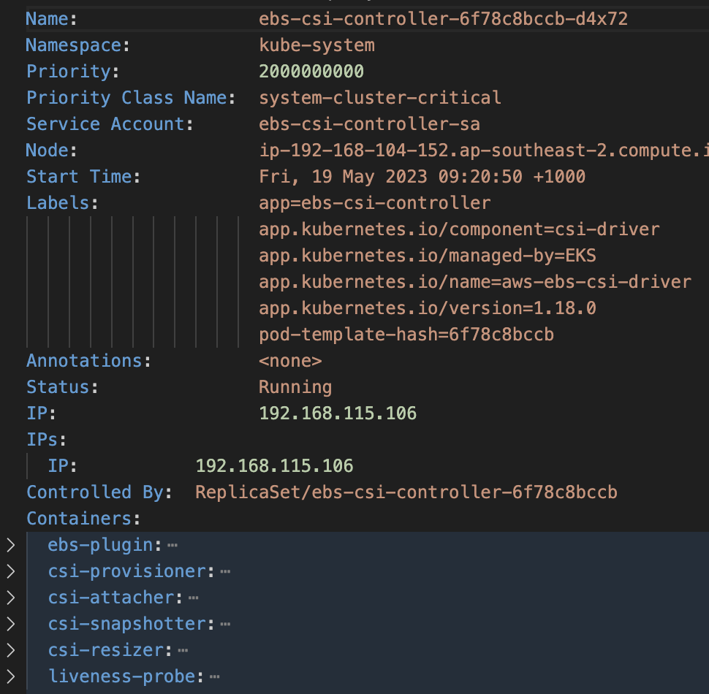
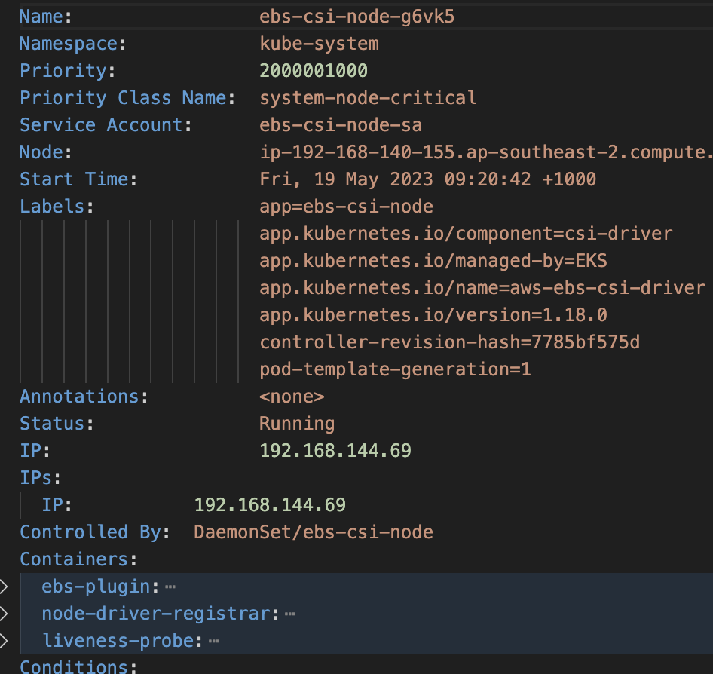
With ebs-csi-driver add-on
Containers in the ebs-csi-controller-xxxxx pod
Containers in the ebs-csi-node-xxxxx pod

Slide 23
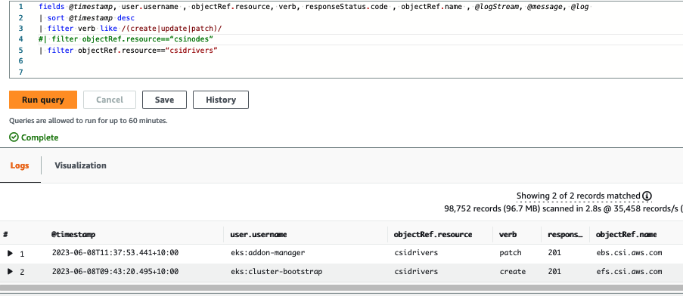
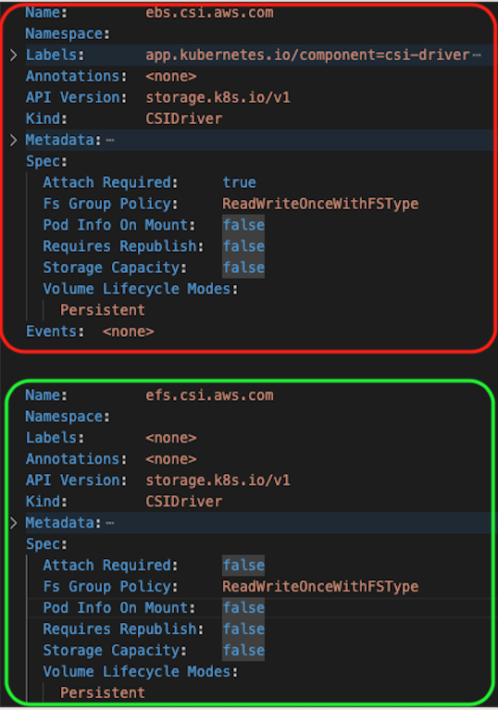
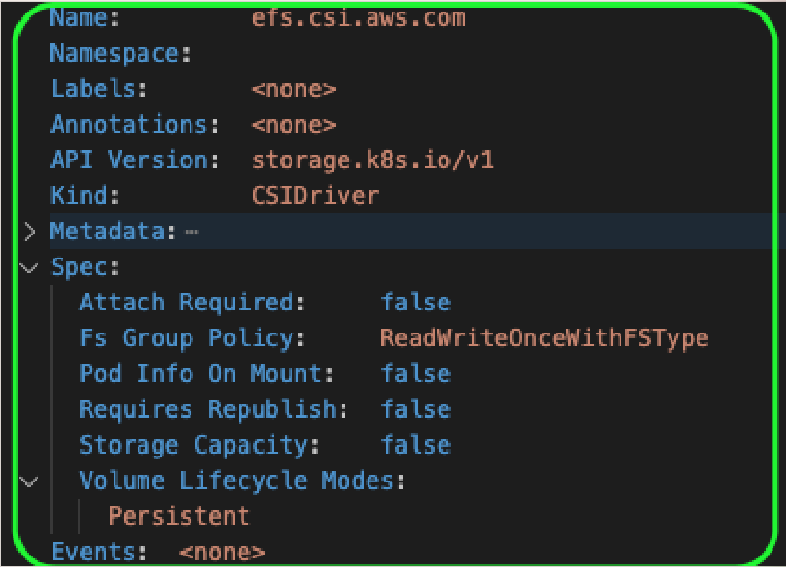
csidriver

Slide 24
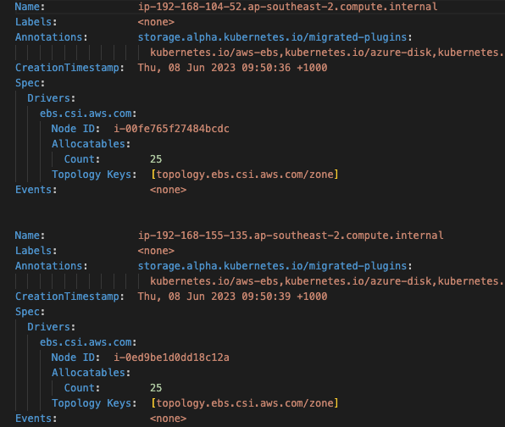
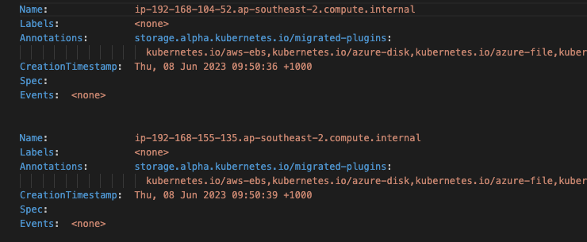
csinode

Slide 25
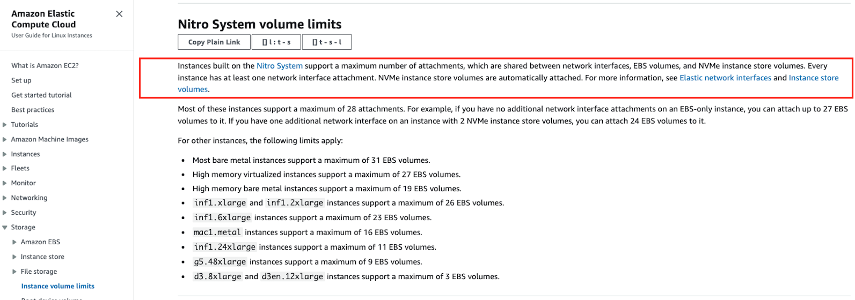
Node object

Slide 26
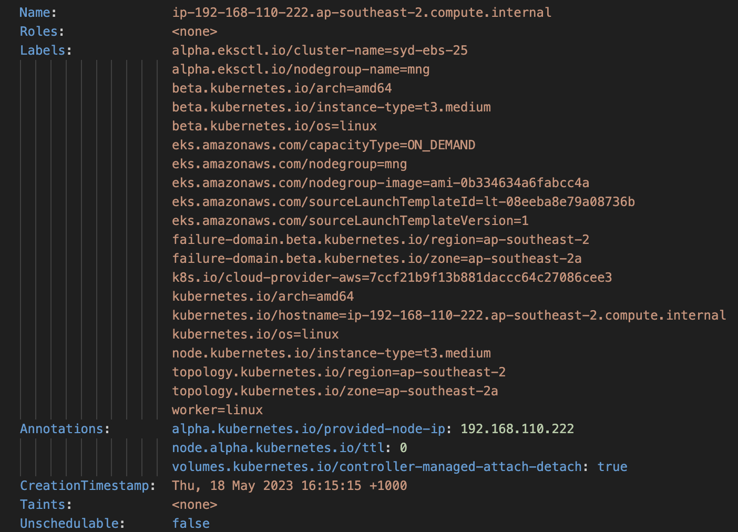
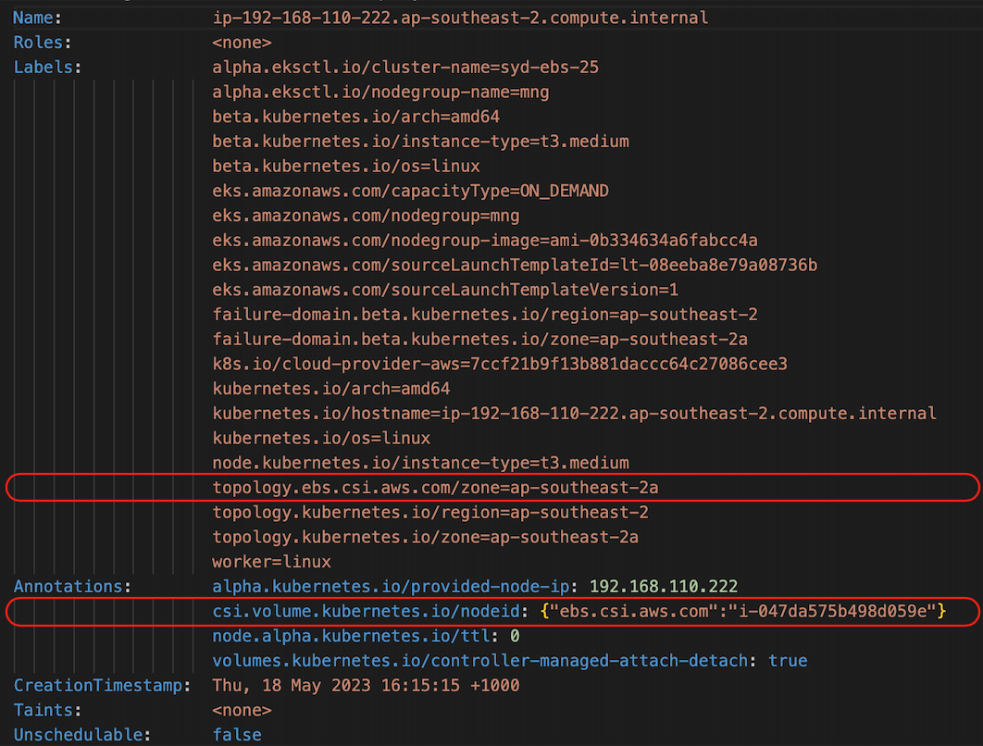
Node object
Before
After

Slide 27
PVC Created
PersistentVolumeClaim Created
3-PVC

Slide 28
Status
SC
Provisioner =ebs.csi.aws.com
No Pod , No action from persistentvolume-binder !
persistentvolume-controller >> waiting for first consumer to be created before binding
Or
StorageClass with “VolumeBindingMode: Immediate”
PVC
kubernetes
AWS EBS
Node OS

Slide 29
Kubernetes Volumes
ebs % kubectl get sc
NAME PROVISIONER RECLAIMPOLICY VOLUMEBINDINGMODE ALLOWVOLUMEEXPANSION AGE
ebs-sc ebs.csi.aws.com Delete WaitForFirstConsumer false 3d11h
gp2(default) kubernetes.io/aws-ebs Delete WaitForFirstConsumer false 6d12h
ebs % kubectl describe sc ebs-sc
Name: ebs-sc
IsDefaultClass: No
Provisioner: ebs.csi.aws.com
Parameters: <none>
AllowVolumeExpansion: <unset>
MountOptions: <none>
ReclaimPolicy: Delete
VolumeBindingMode: WaitForFirstConsumer
Events: <none>
ebs %
ebs % cat ebs-claim.yaml
apiVersion: v1
kind: PersistentVolumeClaim
metadata:
name: ebs-claim
spec:
accessModes:
- ReadWriteOnce
storageClassName: ebs-sc
resources:
requests:
storage: 4Gi

Slide 30
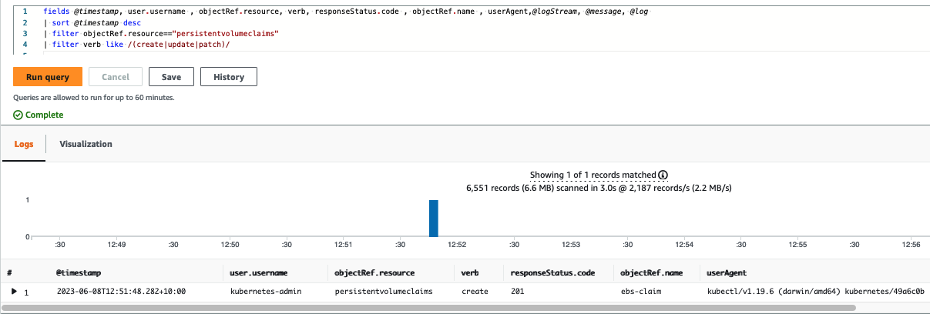
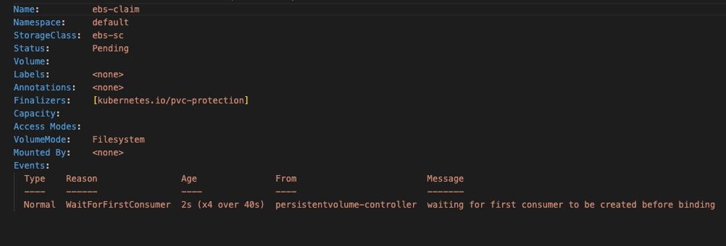
PVC Create

Slide 31
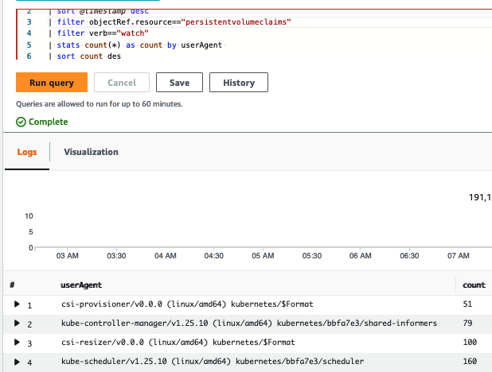
PVC Watchers
Watchers are looking for PVC :
1- kube-APIserver
2- kube-Scheduler
3- kube-Controller-Manager
4- ebs-csi-controller components:

Slide 32
PV Created
PersistentVolume Created
4-PV

Slide 33
Status
SC
Provisioner =ebs.csi.aws.com
PVC
No Pod , But
StorageClass with “VolumeBindingMode: Immediate”
PV
kubernetes
VolumeCreate
AWS EBS
Node OS

Slide 34
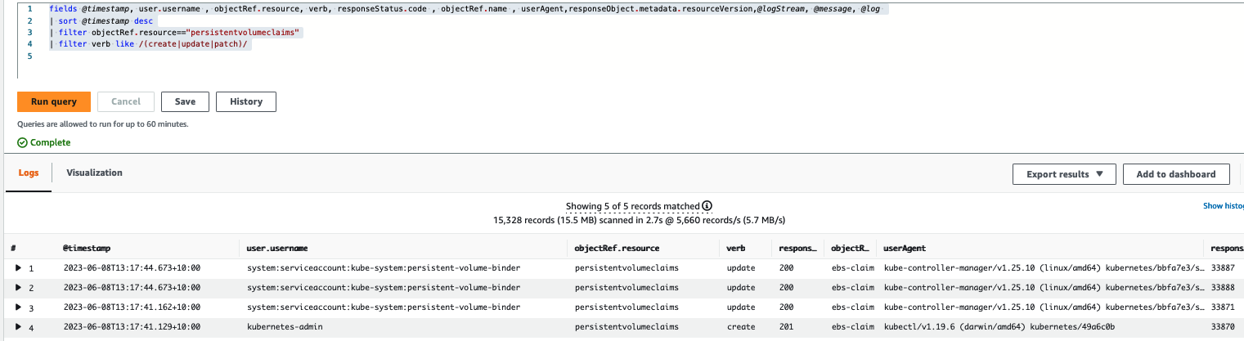
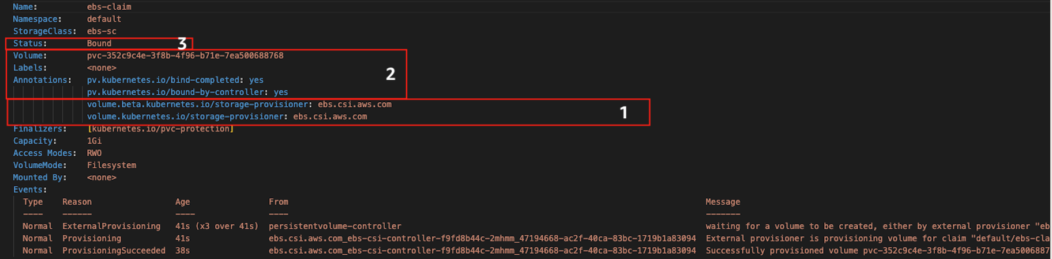
PVC - persistent-volume-binder

Slide 35
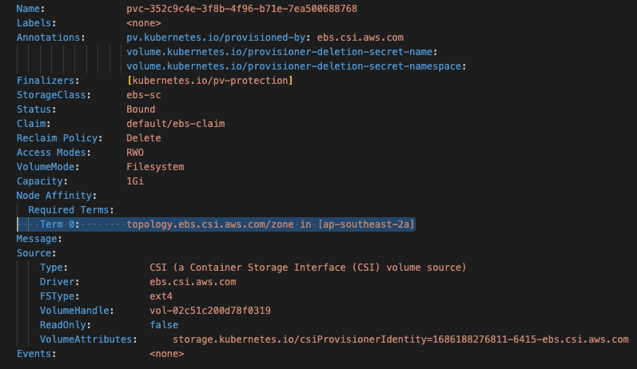
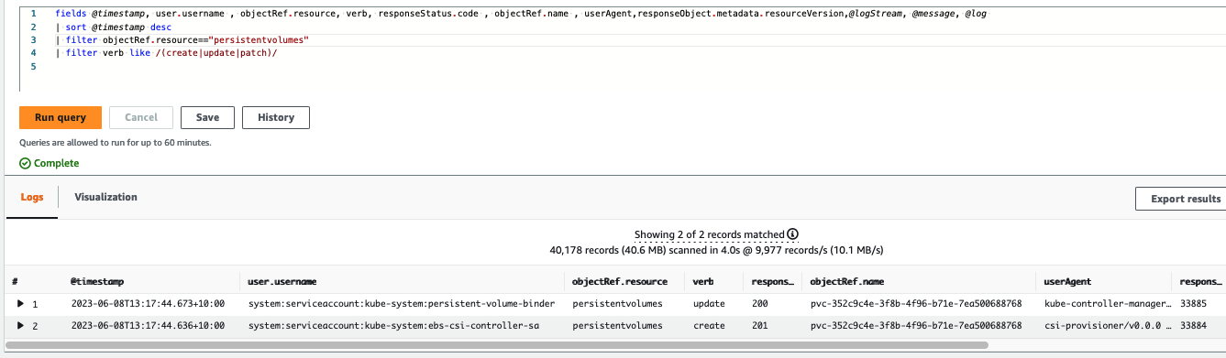
PV Create Update Patch

Slide 36
CSI Containers logs
Provisioner :

Slide 37
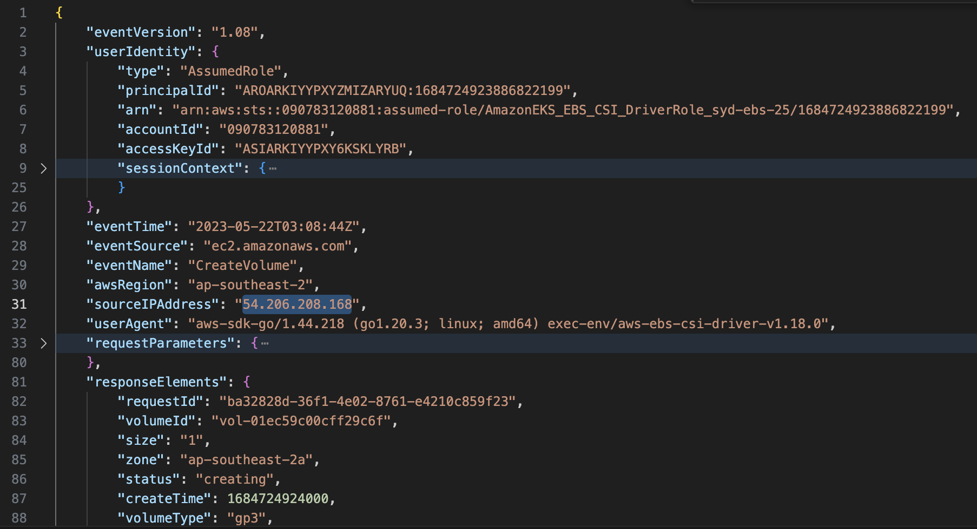
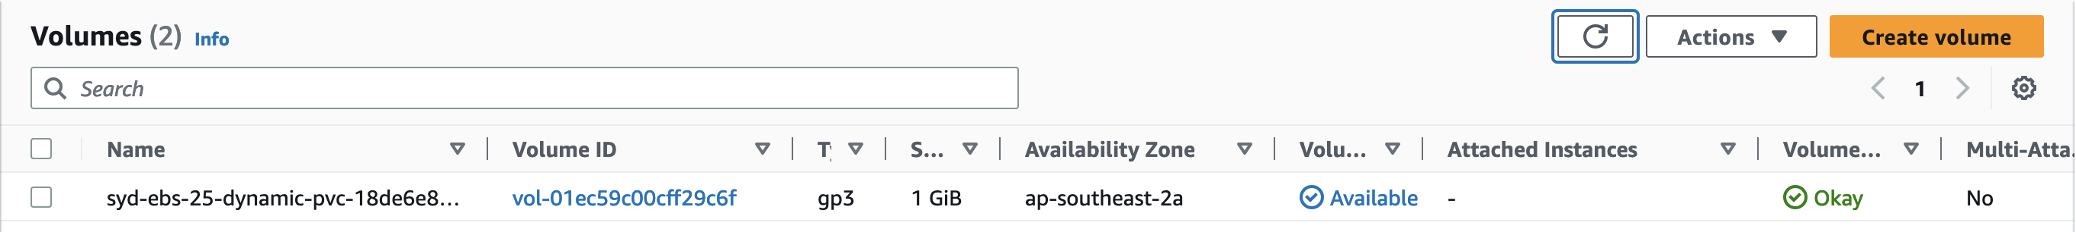
Ctrail : `CreateVolume`

Slide 38
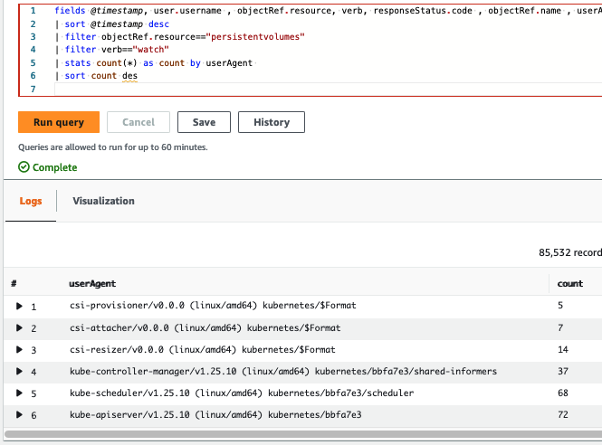
PV Watchers
Watchers are looking for PV :
1- kube-APIserver
2- kube-Scheduler
3- kube-Controller-Manager
4- ebs-csi-controller components:

Slide 39
Volume consumer POD
Pod with volume claim Created
5-POD

Slide 40
Status
SC
Provisioner =ebs.csi.aws.com
PVC
POD
PV
VolumeAttachment
kubernetes
VolumeCreate
VolumeAttach
AWS EBS
Mount
/dev/nvme1n1 on /var/lib/kubelet/plugins/kubernetes.io/csi/ebs.csi.aws.com/588825622994f5a2c3810ec6fecb18af29263c7133c7e65b783dcf38e88e372e/globalmount typeext4 (rw,relatime)
Bind
/dev/nvme1n1 on /var/lib/kubelet/pods/10910bbb-0ae6-4284-9b68-99a7b42f02a9/volumes/kubernetes.io~csi/pvc-18de6e89-4142-410f-bd44-a3c834547ec1/mount type ext4 (rw,relatime)
Node OS

Slide 41
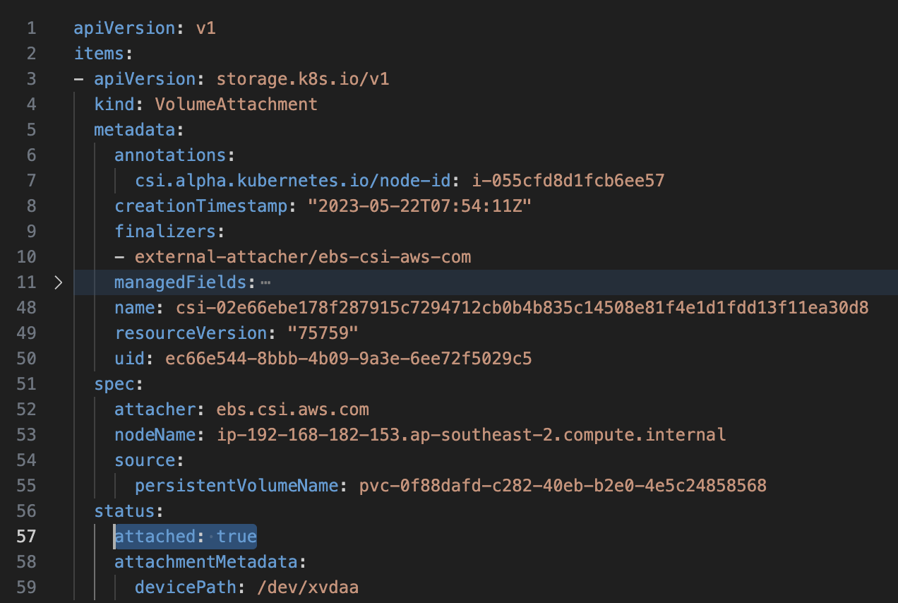
`VolumeAttachment` Object
VolumeAttachment captures the intent to attach or detach the specified volume to/from the specified node. VolumeAttachment objects are non-namespaced.
The external-attacher ( csi-attacher container ) would responds to Kubernetes attach operations and simply do a noop (because the CSI driver did not advertise the PUBLISH_UNPUBLISH_VOLUME controller capability).
The CSI external-attacher is a sidecar container that watches the Kubernetes API server for VolumeAttachment objects and triggers Controller[Publish|Unpublish]Volume operations against a CSI endpoint in order to attach/detach volumes to/from nodes. It is necessary because internal Attach/Detach controller running in Kubernetes controller-manager does not have any direct interfaces to CSI drivers.

Slide 42
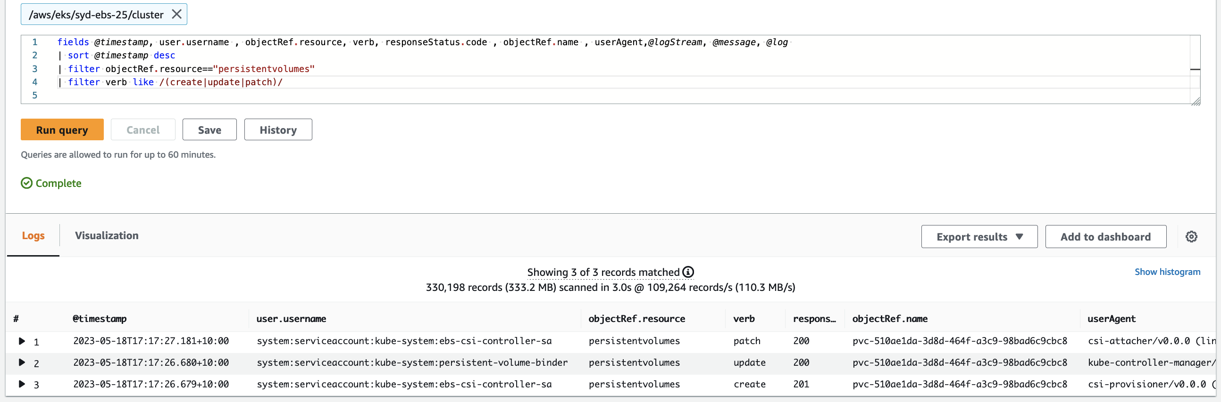
PV – provisioner & attacher

Slide 43
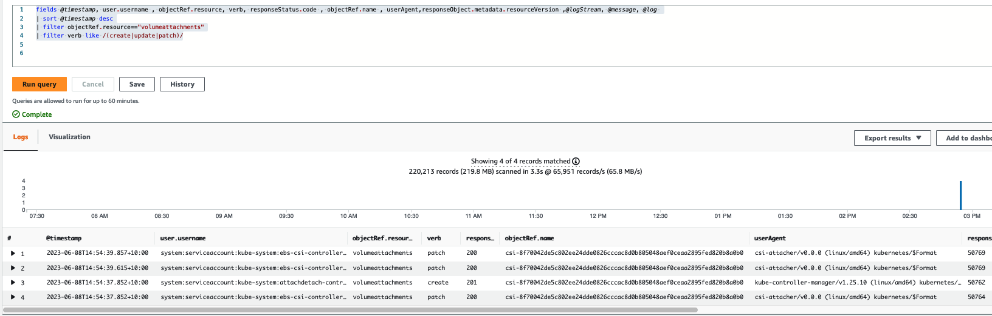
VolumeAttachment
Watchers are looking for PV :
1- kube-APIserver
2- kube-Scheduler
3- kube-Controller-Manager
4- ebs-csi-controller components:

Slide 44
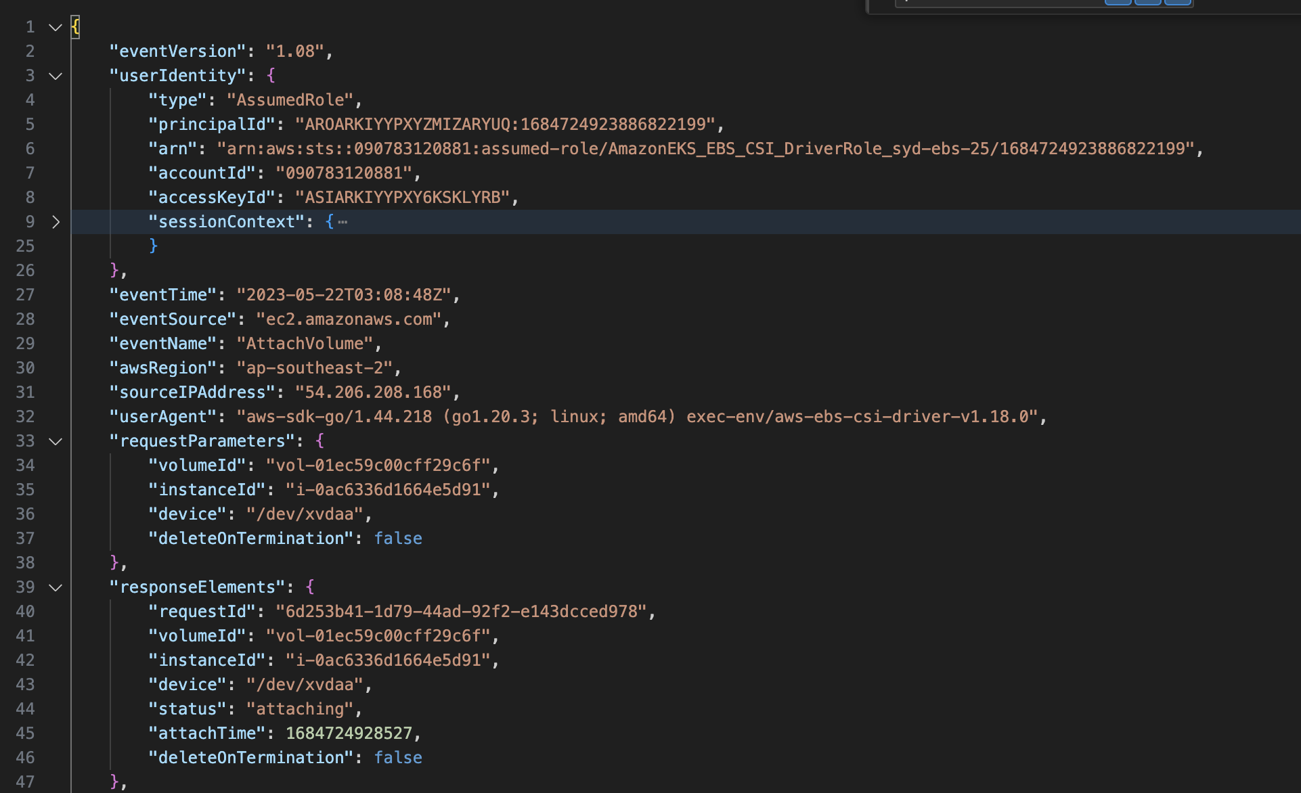
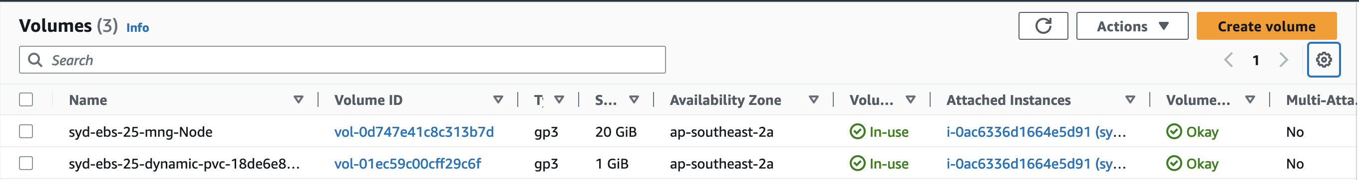
Ctrail `AttachVolume`

Slide 45
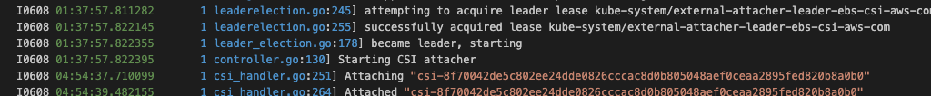
CSI Containers logs
Provisioner :
Attacher :

Slide 46
Node OS volume mount / bind
root@ip-192-168-121-98 ~]# mount | grep "^/dev/nvm”
/dev/nvme0n1p1 on / type xfs (rw,noatime,attr2,inode64,logbufs=8,logbsize=32k,noquota)
/dev/nvme1n1 on /var/lib/kubelet/plugins/kubernetes.io/csi/ebs.csi.aws.com/588825622994f5a2c3810ec6fecb18af29263c7133c7e65b783dcf38e88e372e/globalmount typeext4 (rw,relatime)
/dev/nvme1n1 on /var/lib/kubelet/pods/10910bbb-0ae6-4284-9b68-99a7b42f02a9/volumes/kubernetes.io~csi/pvc-18de6e89-4142-410f-bd44-a3c834547ec1/mount type ext4 (rw,relatime)
root@ip-192-168-121-98 ~]# df -h | grep "^/dev/nvm"
/dev/nvme0n1p1 20G 3.3G 17G 17% /
/dev/nvme1n1 974M 28K 958M 1% /var/lib/kubelet/pods/10910bbb-0ae6-4284-9b68-99a7b42f02a9/volumes/kubernetes.io~csi/pvc-18de6e89-4142-410f-bd44-a3c834547ec1/mount
root@ip-192-168-121-98 ~]#

Slide 47
Summary
Dynamic Provisioning
in
Fast Forward

Slide 48

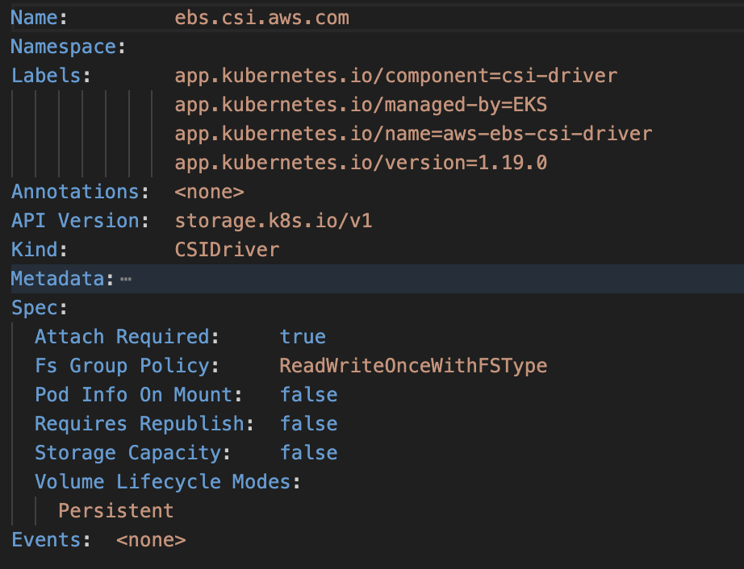
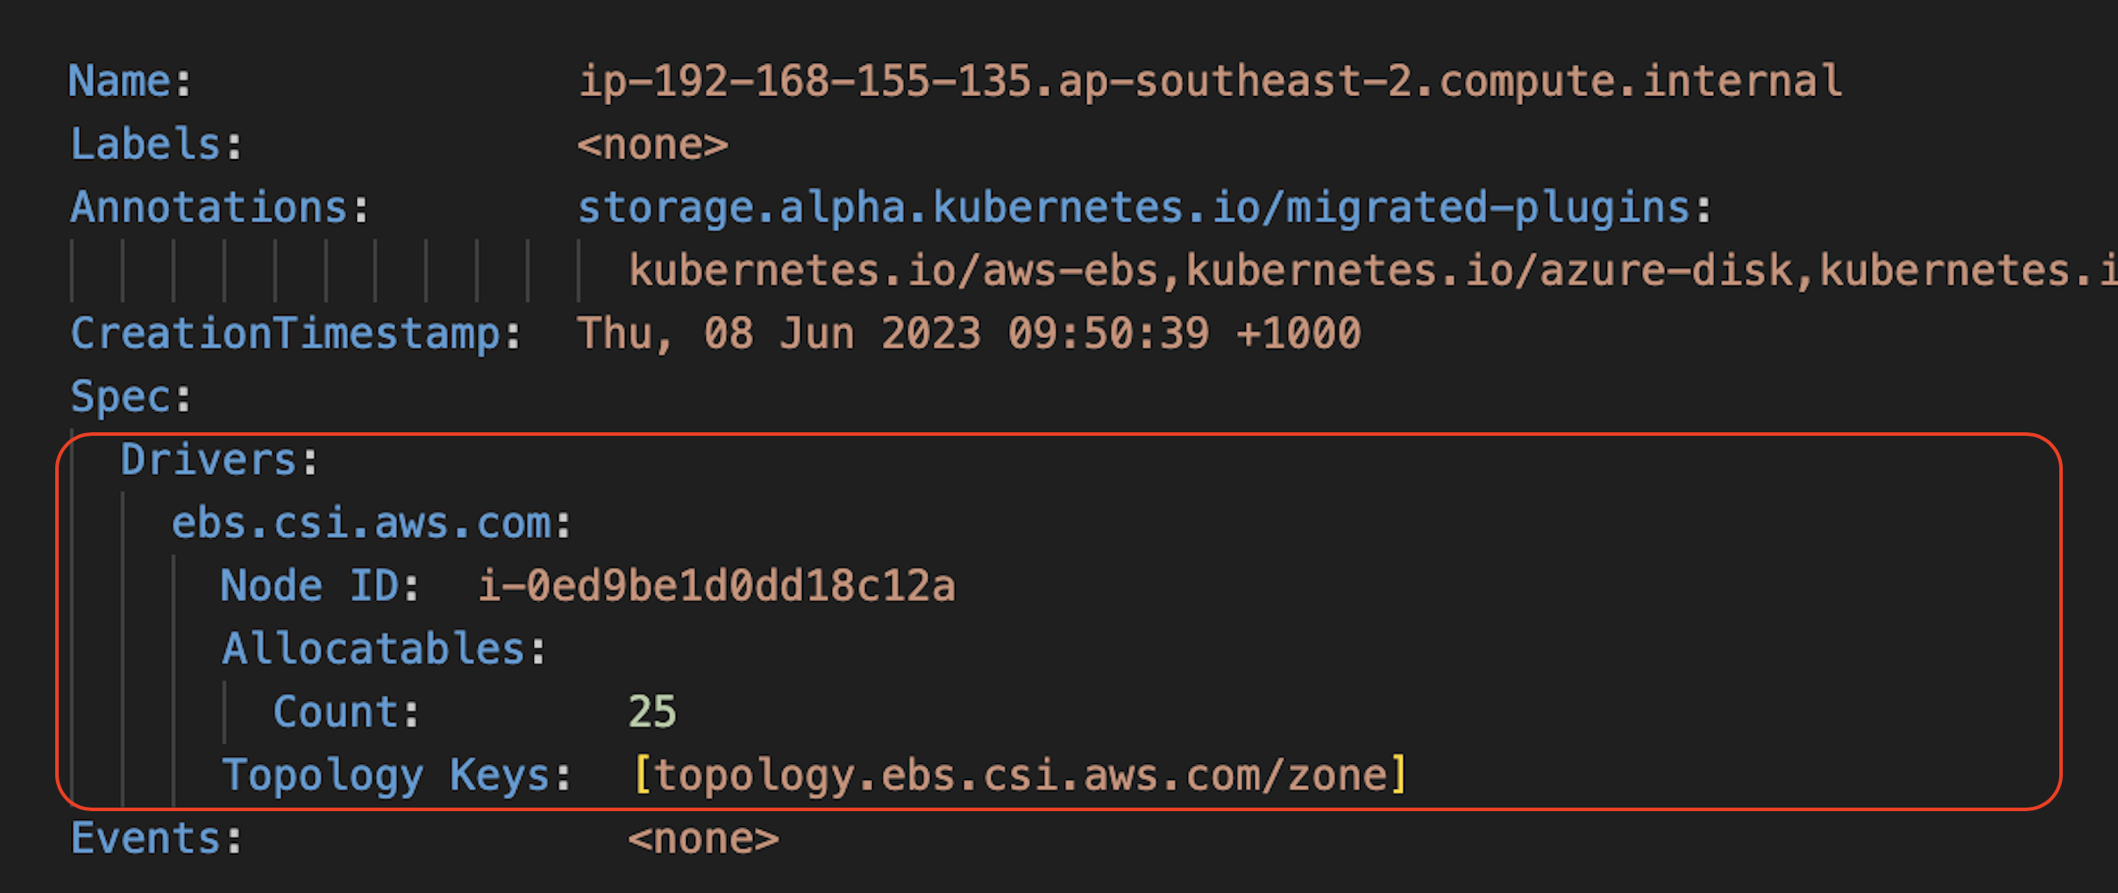
1- ebs.csi.aws.com initialization
Add0n-manager
CSIDriver
Node
CSINode

Slide 49
2- PVC Created

Slide 50
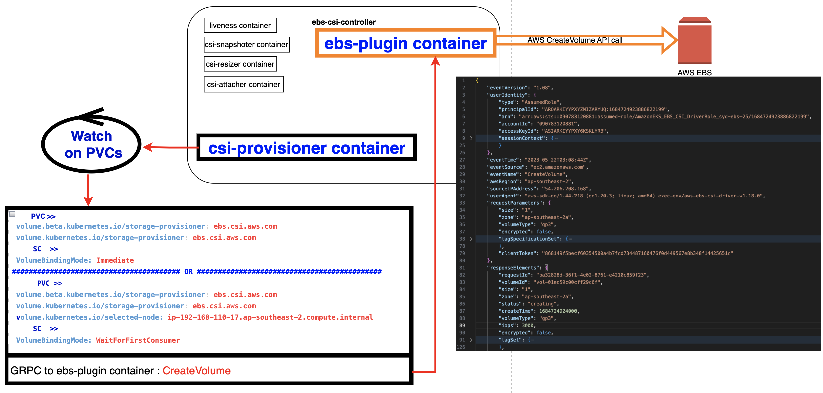
3- CreateVolume

Slide 51
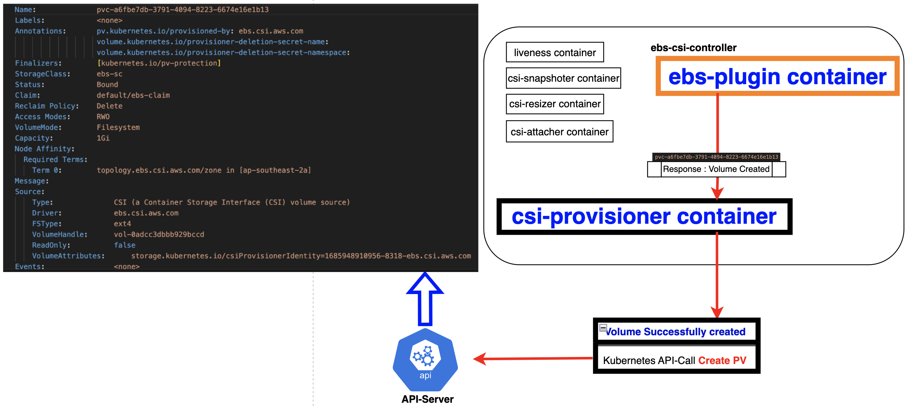
4- PV Create

Slide 52
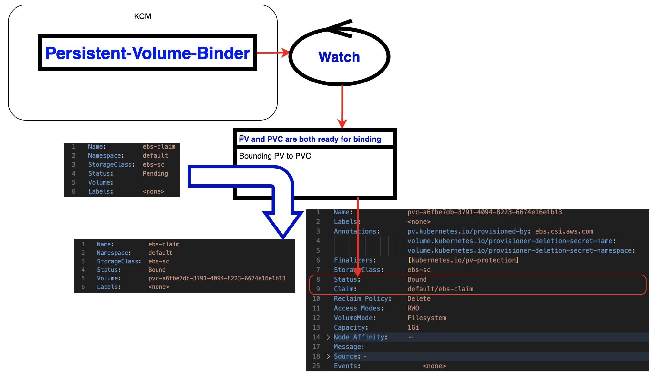
5- PV PVC Binding

Slide 53
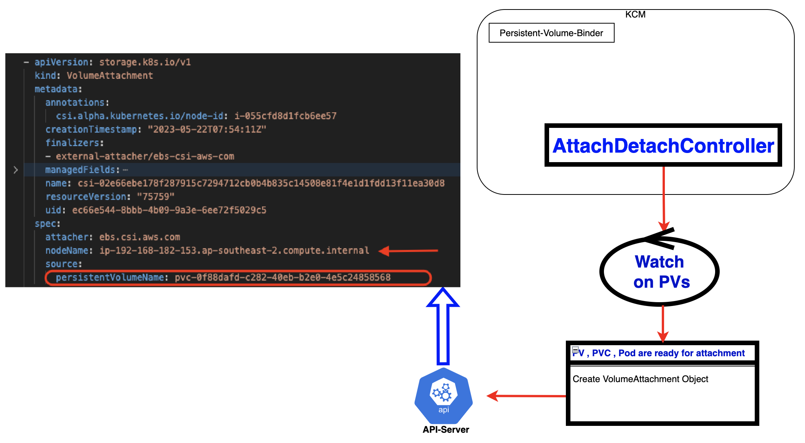
6- Volume Attachment

Slide 54
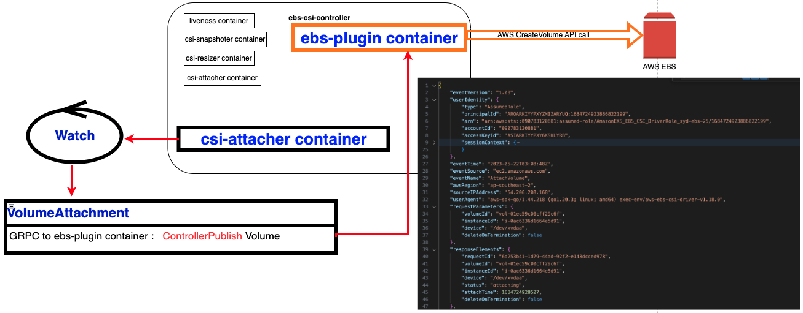
7- attach EBS volume to EC2 node

Slide 55
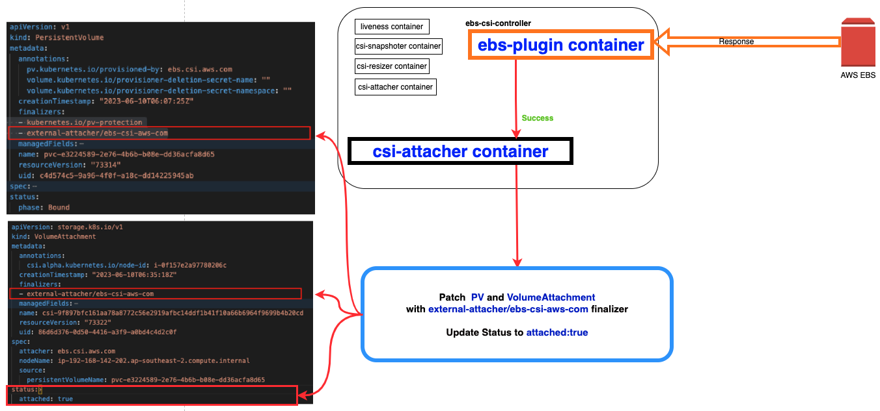
8- Adding Finalizers

Slide 56
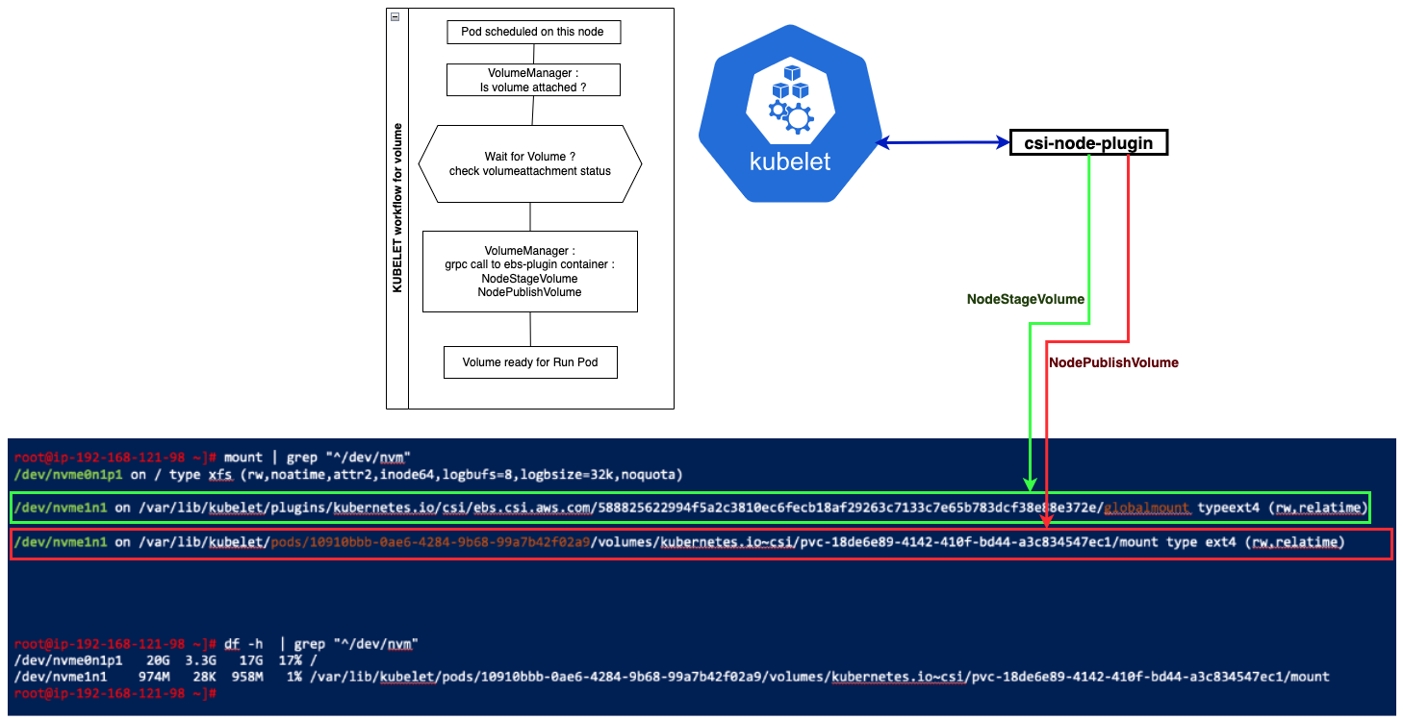
8- BindMount volume to Pod filesystem

Slide 57
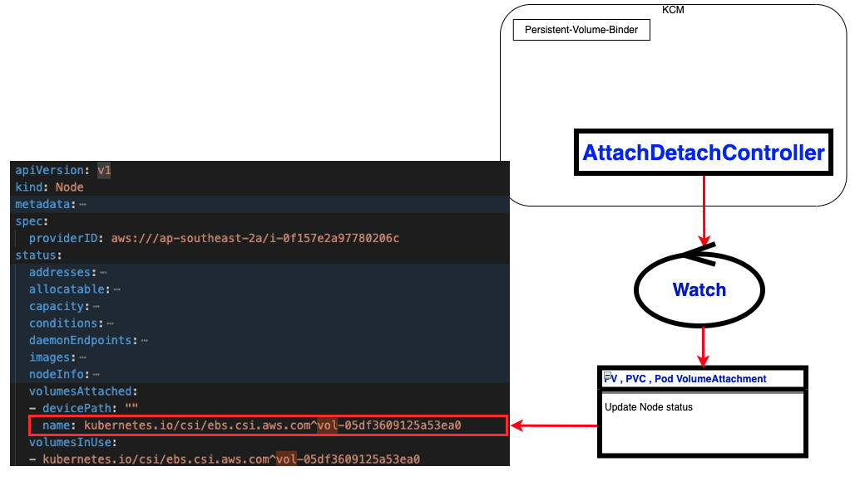
9- Node status change to volume attached
Notes:
fields @timestamp, user.username , objectRef.resource, verb, responseStatus.code , objectRef.name , userAgent,@logStream, @message, @log
| sort @timestamp desc
| filter objectRef.resource=="nodes"
#| filter verb like /(create|update|patch)/
| filter @message like "kubernetes.io/csi/ebs.csi.aws.com"
Attaching volumes :
----------------------------
- AttachDetachController running in the ControlPlane sees there is a Pod using CSI type PV Scheduled ona Node. >>> Creates a `VolumeAttachment` Object
CSI-Attacher container of ebs-csi-controller Pod watches the VolumeAttachment objects >>> Adds Finalizer to PV and VolumeAttachmnet objects : external-attacher/ebs-csi-aws-com
CSI-Attacher Annotations the VolumeAttachment with node-ID : csi.alpha.Kubernetes.io/node-id:i-0xxxxxxxxxx
CSI-Attacher calls ControllPublishVolume over GROC to ebs-olugon container
Ebs-plugin will update the volumeattachment object : status :attached
AttachDetaachController will then update the node.statusvolumesAtached.name=kubenetes.io/csi/ebs.csi.aws.com

Slide 58
Cluster without ebs-csi-driver
Node Deleted Unexpectedly
6-DelNode

Slide 59
Finalizer
How Finalizer is working ?
```yaml
metadata:
annotations:
pv.kubernetes.io/provisioned-by: ebs.csi.aws.com
volume.kubernetes.io/provisioner-deletion-secret-name: ""
volume.kubernetes.io/provisioner-deletion-secret-namespace: ""
creationTimestamp: "2023-06-09T07:11:13Z"
finalizers:
- kubernetes.io/pv-protection
- external-attacher/ebs-csi-aws-com
```

Slide 60
Finalizer
How Finalizer is working ?
Finalizer is protecting objects from accidentally deletion .
When you tell Kubernetes to delete an object that has finalizers specified for it, the Kubernetes API marks the object for deletion by populating .metadata.deletionTimestamp, and returns a `202` status code (HTTP "Accepted").
The target object remains in a terminating state while the control plane, or other components, take the actions defined by the finalizers.
After these actions are complete, the controller removes the relevant finalizers from the target object.
When the metadata.finalizers field is empty, Kubernetes considers the deletion complete and deletes the object.
```yaml
metadata:
annotations:
pv.kubernetes.io/provisioned-by: ebs.csi.aws.com
volume.kubernetes.io/provisioner-deletion-secret-name: ""
volume.kubernetes.io/provisioner-deletion-secret-namespace: ""
creationTimestamp: "2023-06-09T07:11:13Z"
finalizers:
- kubernetes.io/pv-protection
- external-attacher/ebs-csi-aws-com
```

Slide 61

Leader
How the leader selection is happening between two members in the controller pods?

Slide 62
Leader
❯ kubectl -n kube-system get lease
NAME HOLDER AGE
cloud-controller-manager ip-10-0-62-130.ap-southeast-2.compute.internal_7b682ef6-55b1-4c55-a528-ce62c6b86b27 7h
cp-vpc-resource-controller ip-10-0-62-130.ap-southeast-2.compute.internal_b258843e-618b-4236-8efb-dddde3039738 6h59m
ebs-csi-aws-com 1686359567852-2373-ebs-csi-aws-com 4h59m
eks-certificates-controller ip-10-0-62-130.ap-southeast-2.compute.internal 6h59m
external-attacher-leader-ebs-csi-aws-com ebs-csi-controller-f9fd8b44c-8x9rk 4h59m
external-snapshotter-leader-ebs-csi-aws-com ebs-csi-controller-f9fd8b44c-8x9rk 4h59m
kube-controller-manager ip-10-0-62-130.ap-southeast-2.compute.internal_cbda9091-9af1-4a24-ad47-7fa1bcc4055f 7h
kube-scheduler ip-10-0-62-130.ap-southeast-2.compute.internal_1d902689-7d6d-4f6a-9fd7-a6099df1c0d8 6h59m
-----------------------------------------------------------------------------------------------------------------------------------------
❯ kubectl -n kube-system describe lease external-attacher-leader-ebs-csi-aws-com
Name: external-attacher-leader-ebs-csi-aws-com
Namespace: kube-system
Labels: <none>
Annotations: <none>
API Version: coordination.k8s.io/v1
Kind: Lease
Metadata:
Creation Timestamp: 2023-06-10T01:12:49Z
Time: 2023-06-10T08:35:22Z
Resource Version: 94197
UID: 842b816f-8393-4a53-9352-7ebdb64bf07e
Spec:
Acquire Time: 2023-06-10T01:12:49.274871Z
Holder Identity: ebs-csi-controller-f9fd8b44c-8x9rk
Lease Duration Seconds: 15
Lease Transitions: 0
Renew Time: 2023-06-10T08:35:22.213991Z
Events:
~

Slide 63

Using Annotation in EBS-CSI-Driver migration

Slide 64
Cluster without ebs-csi-driver
Pod Deleted accidentally
7-DelPOD

Slide 65
Cluster without ebs-csi-driver
PVC Deleted
8-DelPVC

Slide 66
Cluster without ebs-csi-driver
PV Deleted
9-DelPV

Slide 67

AWS `DetachVolume` API-Call

Slide 68
Cluster without ebs-csi-driver
Q/A

Slide 69
Kubernetes CSI Sidecar Containers
Kubernetes CSI Sidecar Containers
Kubernetes CSI Sidecar Containers are a set of standard containers that aim to simplify the development and deployment of CSI Drivers on Kubernetes.
These containers contain common logic to watch the Kubernetes API, trigger appropriate operations against the “CSI volume driver” container, and update the Kubernetes API as appropriate.
The containers are intended to be bundled with third-party CSI driver containers and deployed together as pods.
The containers are developed and maintained by the Kubernetes Storage community.
The Kubernetes development team maintains the following Kubernetes CSI Sidecar Containers:
external-provisioner
external-attacher
external-snapshotter
external-resizer
node-driver-registrar
cluster-driver-registrar (deprecated)
livenessprobe

Slide 70
Registerer
Description
The CSI node-driver-registrar is a sidecar container that fetches driver information (using NodeGetInfo) from a CSI endpoint and registers it with the kubelet on that node using the kubelet plugin registration mechanism.
Usage
Kubelet directly issues CSI NodeGetInfo, NodeStageVolume, and NodePublishVolume calls against CSI drivers. It uses the kubelet plugin registration mechanism to discover the unix domain socket to talk to the CSI driver. Therefore, all CSI drivers should use this sidecar container to register themselves with kubelet.

Slide 71
Description The CSI external-provisioner is a sidecar container that watches the Kubernetes API server for PersistentVolumeClaim objects. It calls CreateVolume against the specified CSI endpoint to provision a new volume. Volume provisioning is triggered by the creation of a new Kubernetes PersistentVolumeClaim object, if the PVC references a Kubernetes StorageClass, and the name in the provisioner field of the storage class matches the name returned by the specified CSI endpoint in the GetPluginInfo call. Once a new volume is successfully provisioned, the sidecar container creates a Kubernetes PersistentVolume object to represent the volume. The deletion of a PersistentVolumeClaim object bound to a PersistentVolume corresponding to this driver with a delete reclaim policy causes the sidecar container to trigger a DeleteVolume operation against the specified CSI endpoint to delete the volume. Once the volume is successfully deleted, the sidecar container also deletes the PersistentVolume object representing the volume. DataSources The external-provisioner provides the ability to request a volume be pre-populated from a data source during provisioning. For more information on how data sources are handled see DataSources.
Provisioner

Slide 72
Attacher
Description
The CSI external-attacher is a sidecar container that watches the Kubernetes API server for VolumeAttachment objects and triggers Controller[Publish|Unpublish]Volume operations against a CSI endpoint.
Usage
CSI drivers that require integrating with the Kubernetes volume attach/detach hooks should use this sidecar container, and advertise the CSI PUBLISH_UNPUBLISH_VOLUME controller capability.

Slide 73
Resizer
Description
The CSI external-resizer is a sidecar container that watches the Kubernetes API server for PersistentVolumeClaim object edits and triggers ControllerExpandVolume operations against a CSI endpoint if user requested more storage on PersistentVolumeClaim object.
Usage
CSI drivers that support Kubernetes volume expansion should use this sidecar container, and advertise the CSI VolumeExpansion plugin capability.

Slide 74
Snapshotter
Description
The CSI external-snapshotter is a sidecar container that watches the Kubernetes API server for VolumeSnapshot and VolumeSnapshotContent CRD objects.
The creation of a new VolumeSnapshot object referencing a SnapshotClass CRD object corresponding to this driver causes the sidecar container to trigger a CreateSnapshot operation against the specified CSI endpoint to provision a new snapshot. When a new snapshot is successfully provisioned, the sidecar container creates a Kubernetes VolumeSnapshotContent object to represent the new snapshot.
The deletion of a VolumeSnapshot object bound to a VolumeSnapshotContent corresponding to this driver with a delete deletion policy causes the sidecar container to trigger a DeleteSnapshot operation against the specified CSI endpoint to delete the snapshot. Once the snapshot is successfully deleted, the sidecar container also deletes the VolumeSnapshotContent object representing the snapshot.
Usage
CSI drivers that support provisioning volume snapshots and the ability to provision new volumes using those snapshots should use this sidecar container, and advertise the CSI CREATE_DELETE_SNAPSHOT controller capability.

Slide 75
Liveness
Description
The CSI livenessprobe is a sidecar container that monitors the health of the CSI driver and reports it to Kubernetes via the Liveness Probe mechanism. This enables Kubernetes to automatically detect issues with the driver and restart the pod to try and fix the issue.
Usage
All CSI drivers should use the liveness probe to improve the availability of the driver while deployed on Kubernetes.

